Slide 1
Implement SZ Compression in XIOS for Weather Forecasting Date: June 9th 2023 Presenter: Dian Hanifudin Subhi

Slide 2
Summary
Integrate SZ Compression in XIOS
Preparing Different Scenarios
Experiment Result

Slide 3
Integrate SZ Compression in XIOS
Introduction
XIOS, is a library for managing climate data I/O. The configuration is based on XML.
SZ is lossless compression that offer high compression ratio supported C and Fortran API.

Slide 4
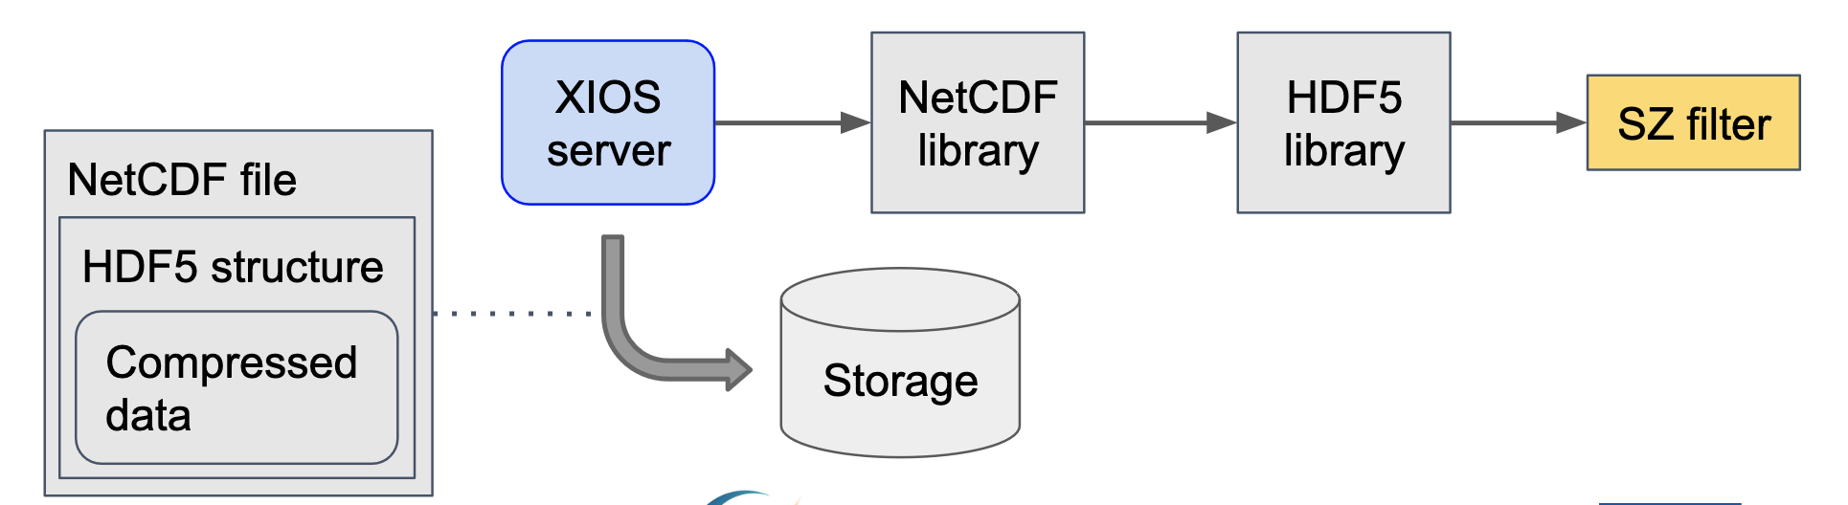
Integrate SZ Compression in XIOS
Proposed Integration
The climate data uses NetCDF format to store the model.
The H5Z-SZ filter support to apply SZ compression for NetCDF4 format
The approach to implement SZ compression as shown below figure

Slide 5
Preparing Different Scenarios
VCS Branching
The different scenarios and configurations are needed to perform different scenarios evaluation
The Low GloSea6 codebase is managed using subversion + FCM and the XIOS codebase is managed using git
The VCS supports creating branches to help develop and incubate features. This feature can help to have different scenarios without comment/uncomment code.

Slide 6
Preparing Different Scenarios
Examples
Applied different branches for scenarios:
Nocompress: branches/dev/changwon
gzip: branches/dev/hongik
Other examples:
main: stable branch at production
develop: pre-production code
feature/x-feature: development of new feature

Slide 7
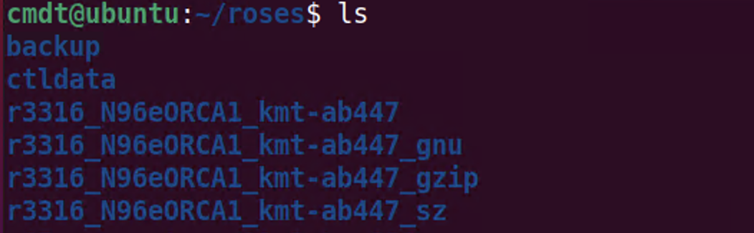
Experiment Results
Run Scenario
Scenario
nocompress: r3316_N96eORCA1_kmt-ab447_gnu
gzip: r3316_N96eORCA1_kmt-ab447_gzip

Slide 8
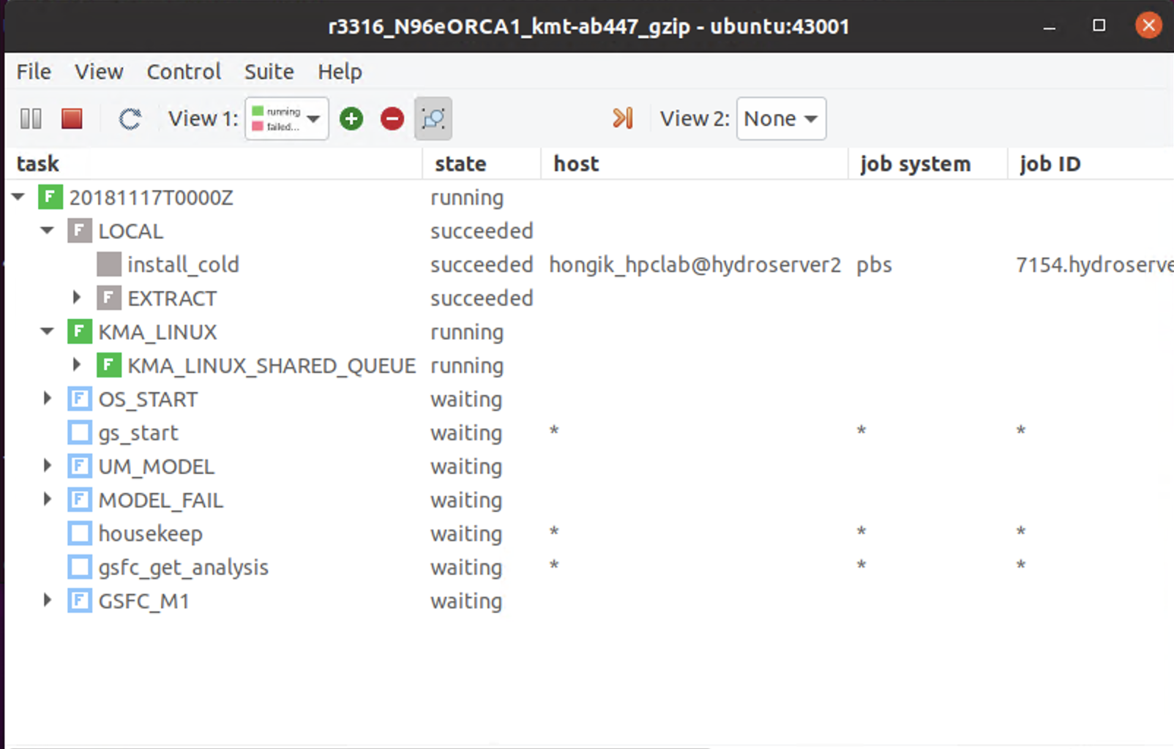
Experiment Results
Run Scenario

Slide 9
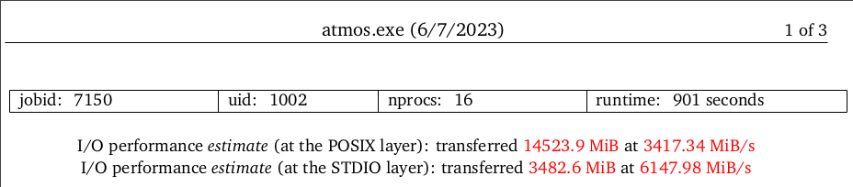
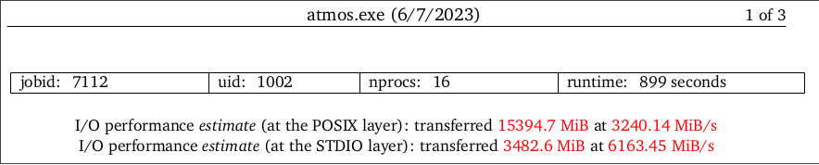
Experiment Results
Current comparison result regarding enabled compression
Enable default compression can improve I/O performance by ~6% for the current evaluation profiled by Darshan as shown in the figure below.

Slide 10
Conclusion/Your thoughts
The XIOS default gzip compression has been enabled from Low GloSea6 and can improve the I/O performance
The H5Z-SZ filter needs to be tested for SZ compression integration in XIOS.

Slide 11
Action items
Implementing SZ compression in XIOS used the H5Z-SZ filter from NetCDF API calls.
Modified XIOS to perform SZ compression by utilizing

